Slide 1
Water potability prediction using Machine Learning.
Mentor name :
Members:
Akash Pawar
Atharva Sangar
Sameer Chavan
Urvi Mulchandani
Shrawan Kumar Kumawat
Apurva Patil

Slide 2
Objective
To predict the potability of water based on the properties of the water. Categorizing the water as potable or not potable with highest accuracy.

Slide 3
Workflow
Importing required libraries.
Importing the data.
Performing exploratory data analysis.
Identifying imputation techniques.
Model building.
Model evaluation.
Deployment.

Slide 4
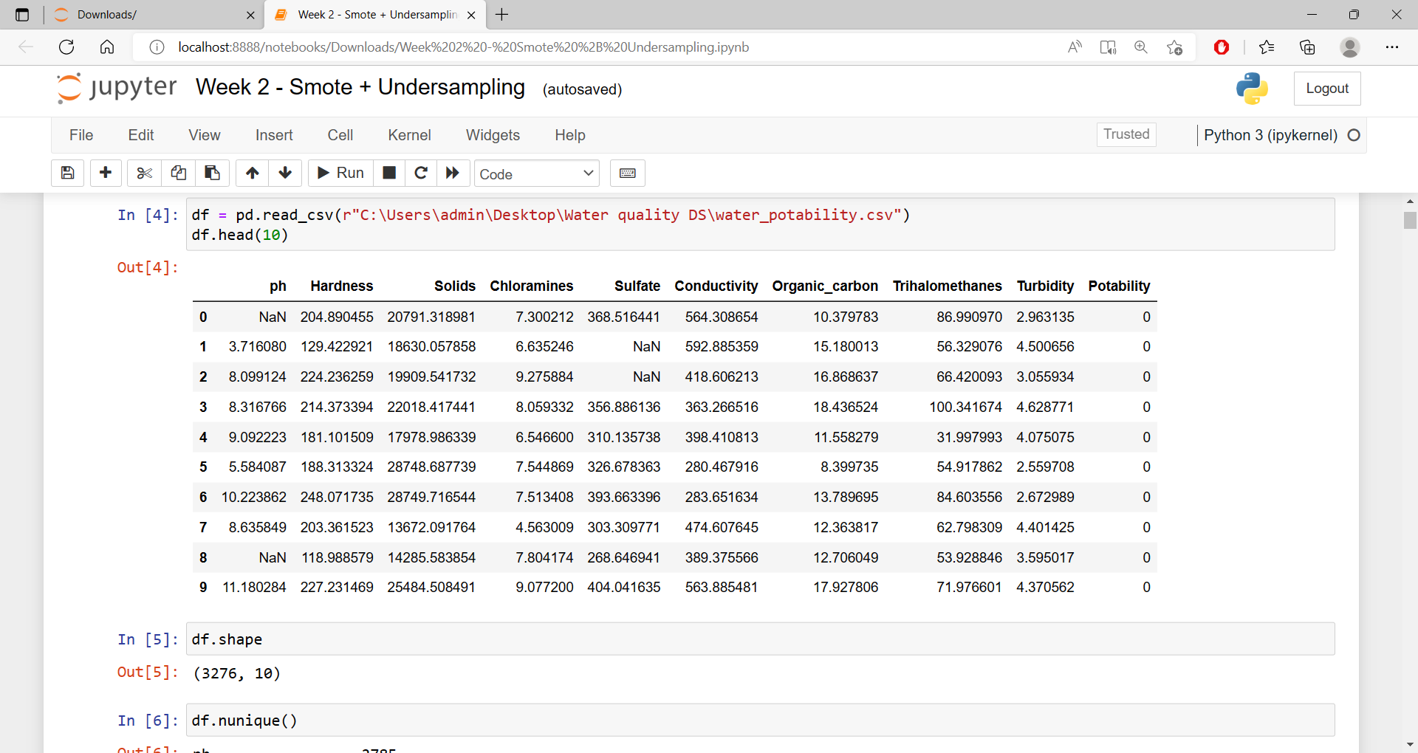
Exploratory Data Analysis
Number of rows - 3276
Number of columns – 10

Slide 5
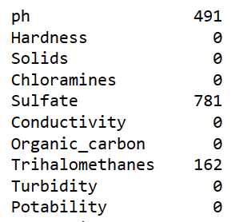
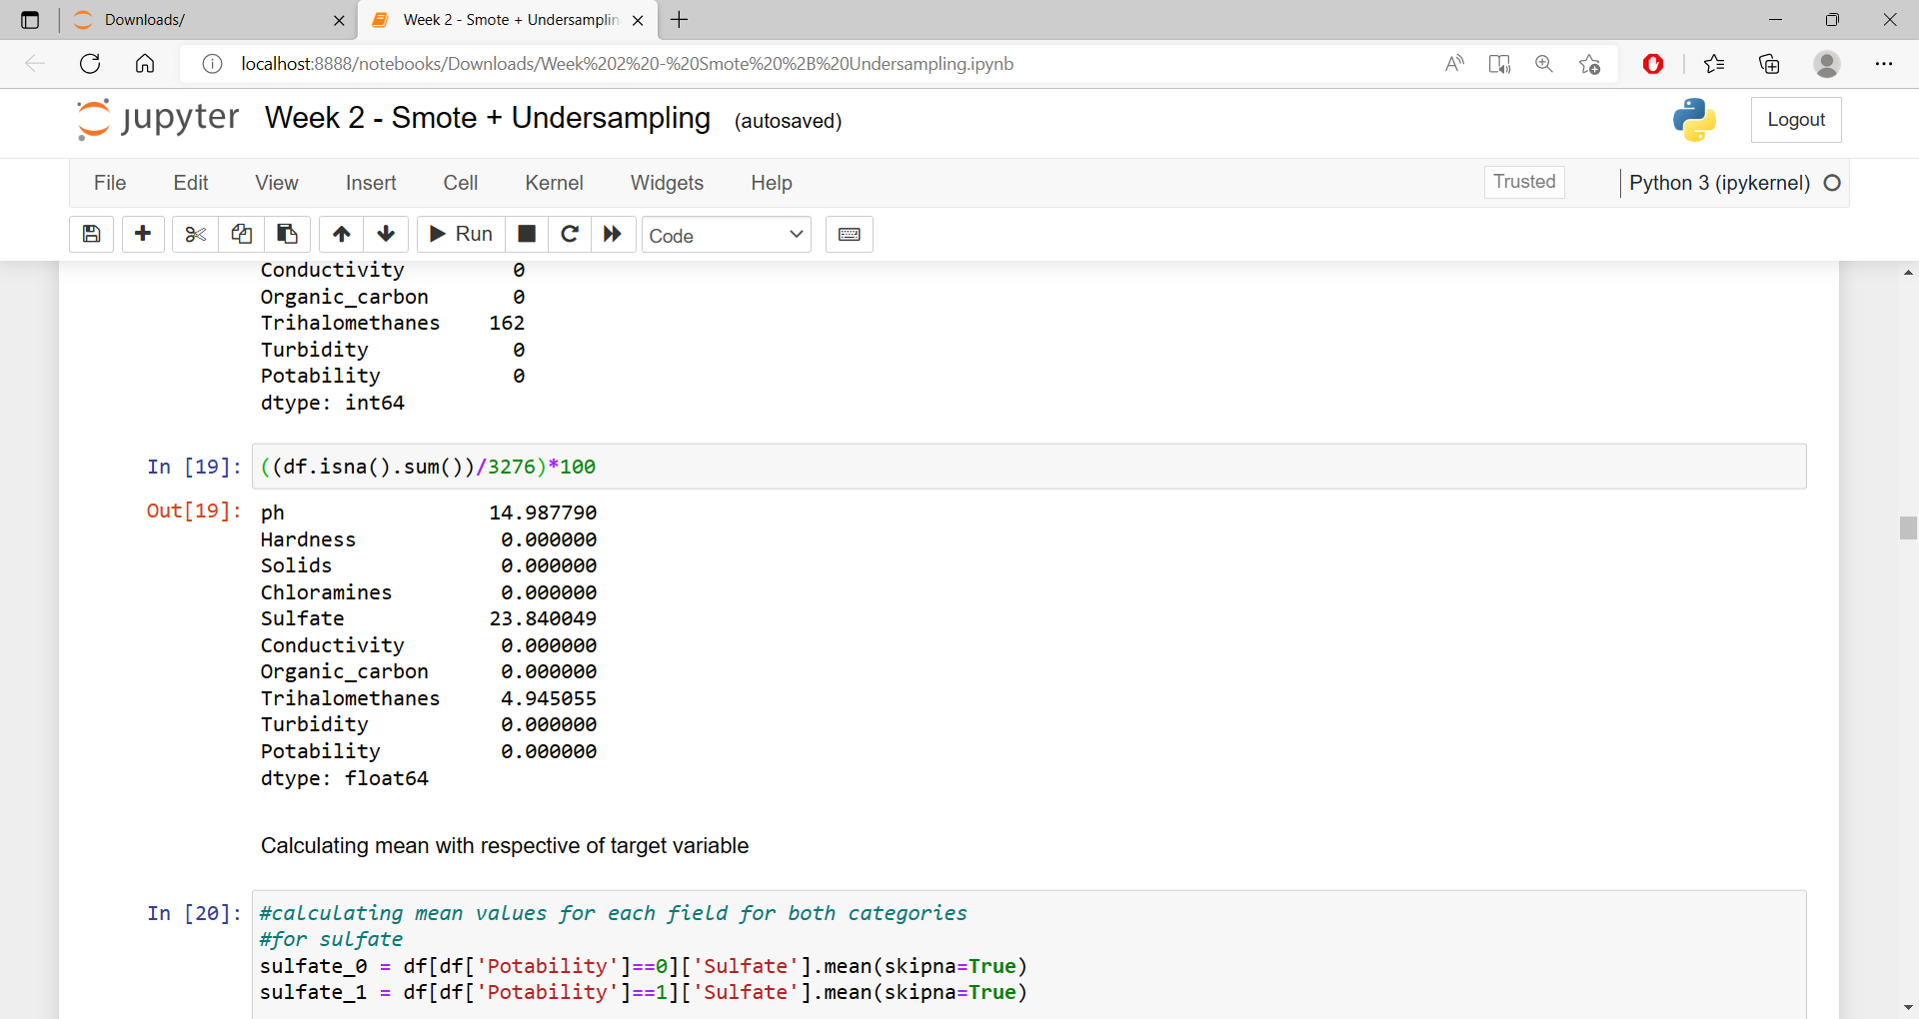
Null values & their percentage

Slide 6
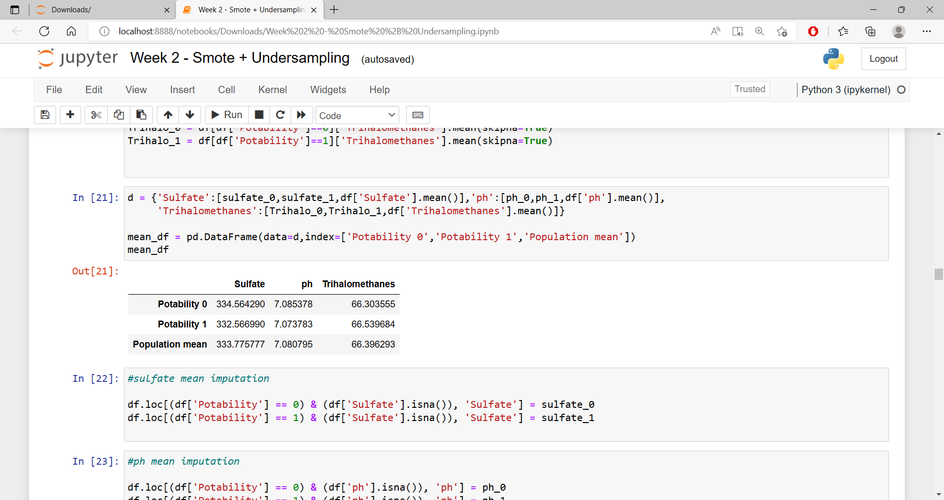
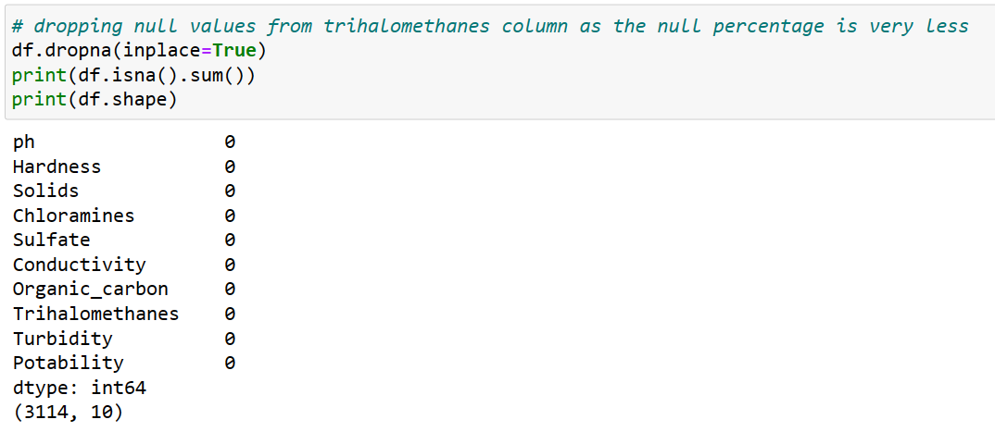
Imputation
No significant difference found in mean based on target variables. So we proceed to fill null values for each column by target wise mean for Sulfate and ph.
Then we deleted null values from Trihalomethanes column as it had the lowest amount of null values.

Slide 7
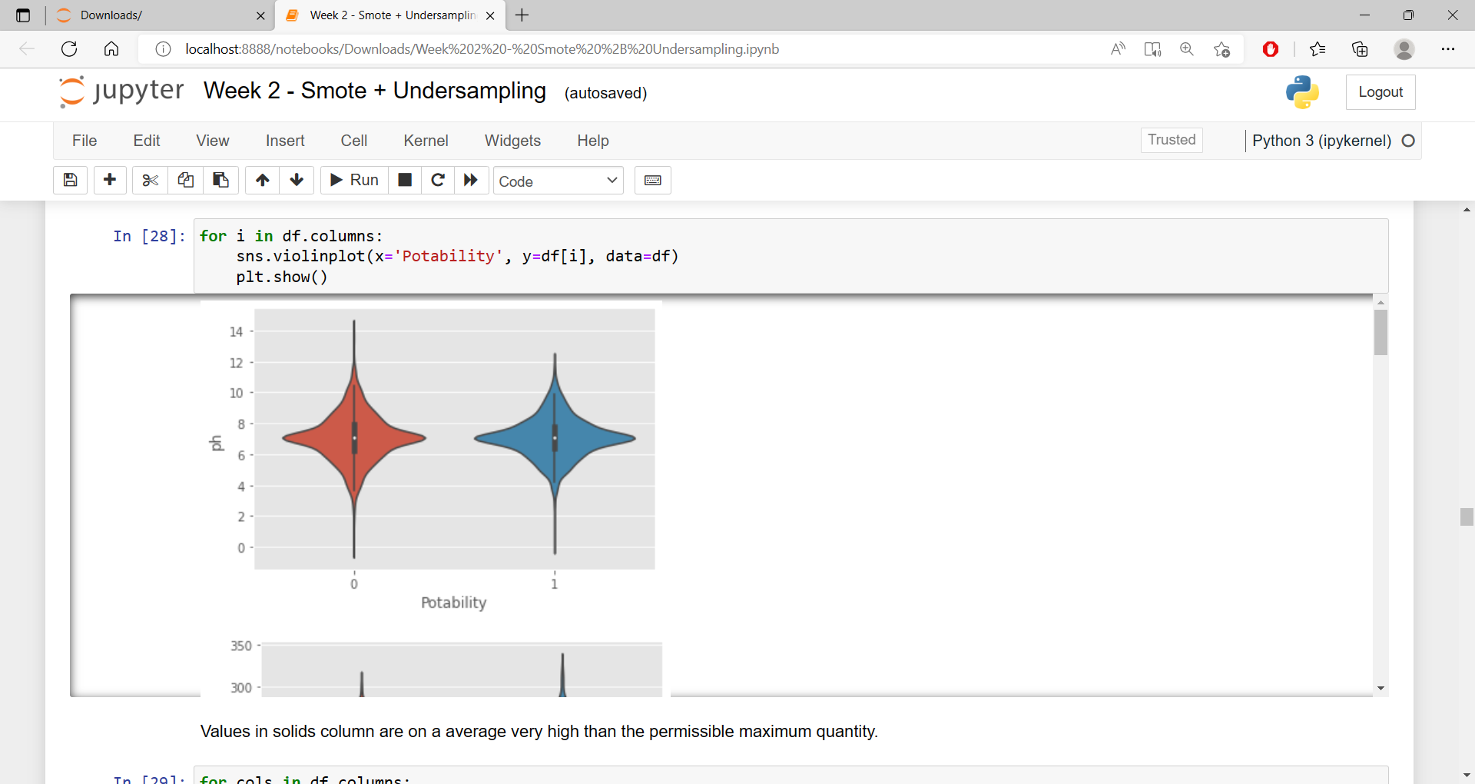
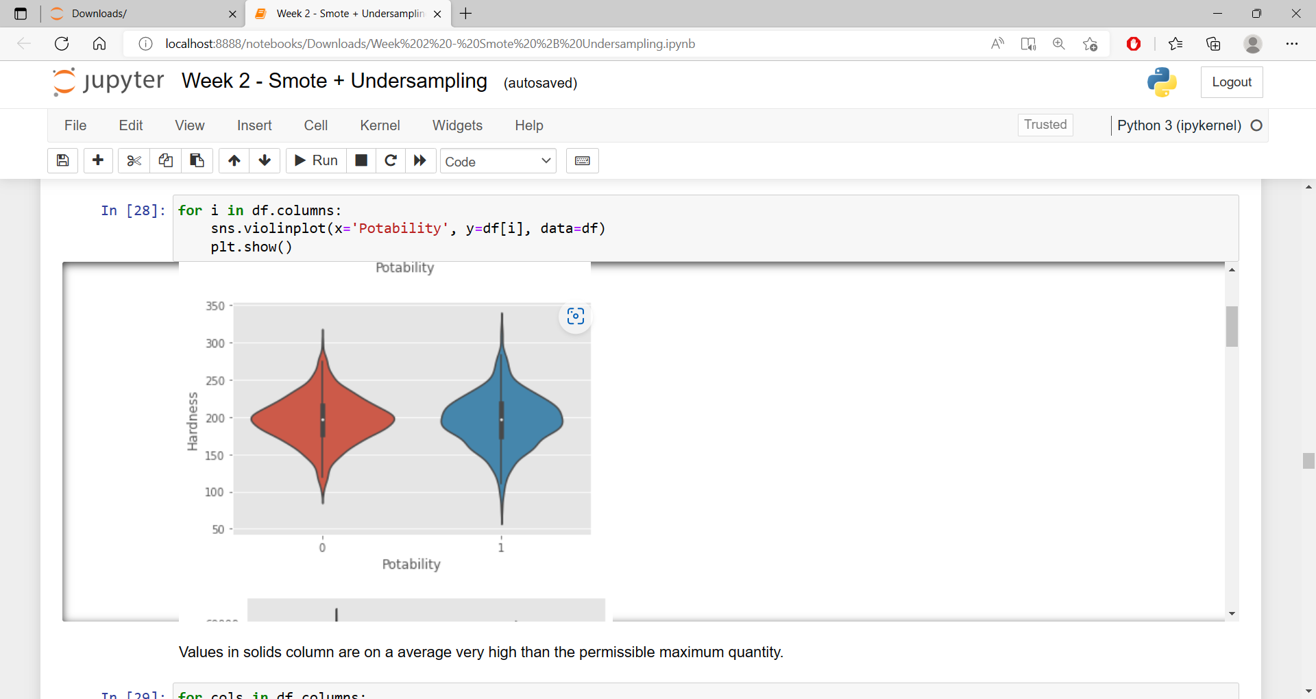
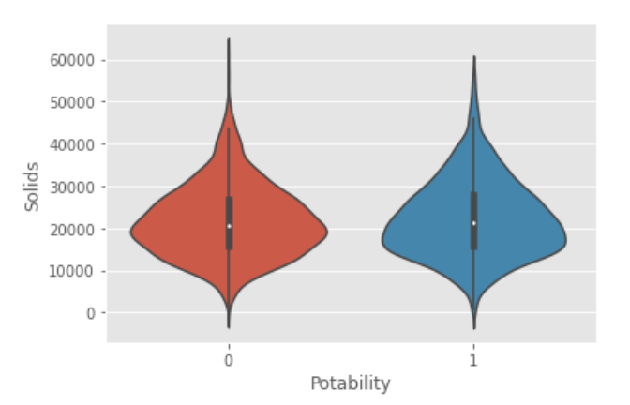
Multi-variate analysis
Solids column has high average value of around 22 thousand while its maximum permissible limit is
1000 mg/l. Which may cause discrepancy in the model performance.

Slide 8
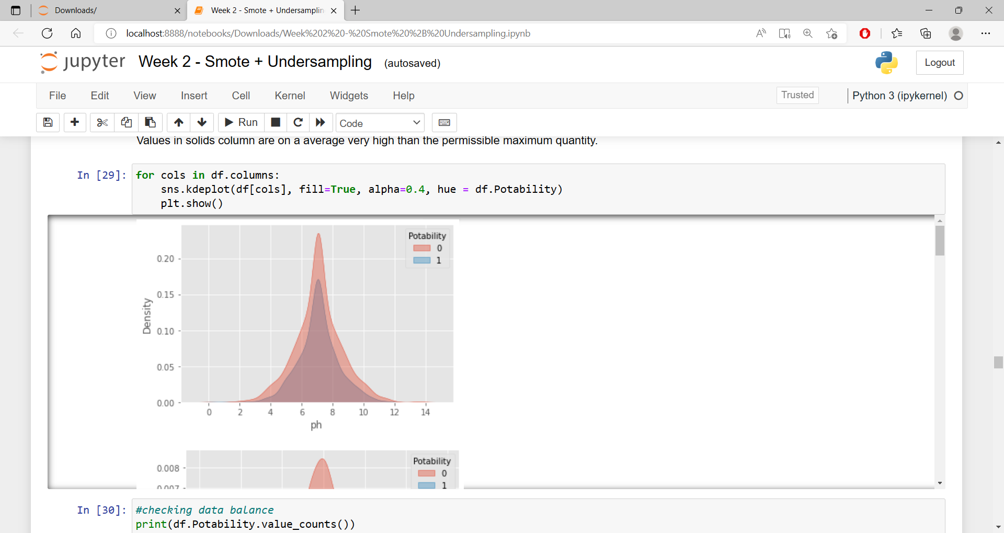
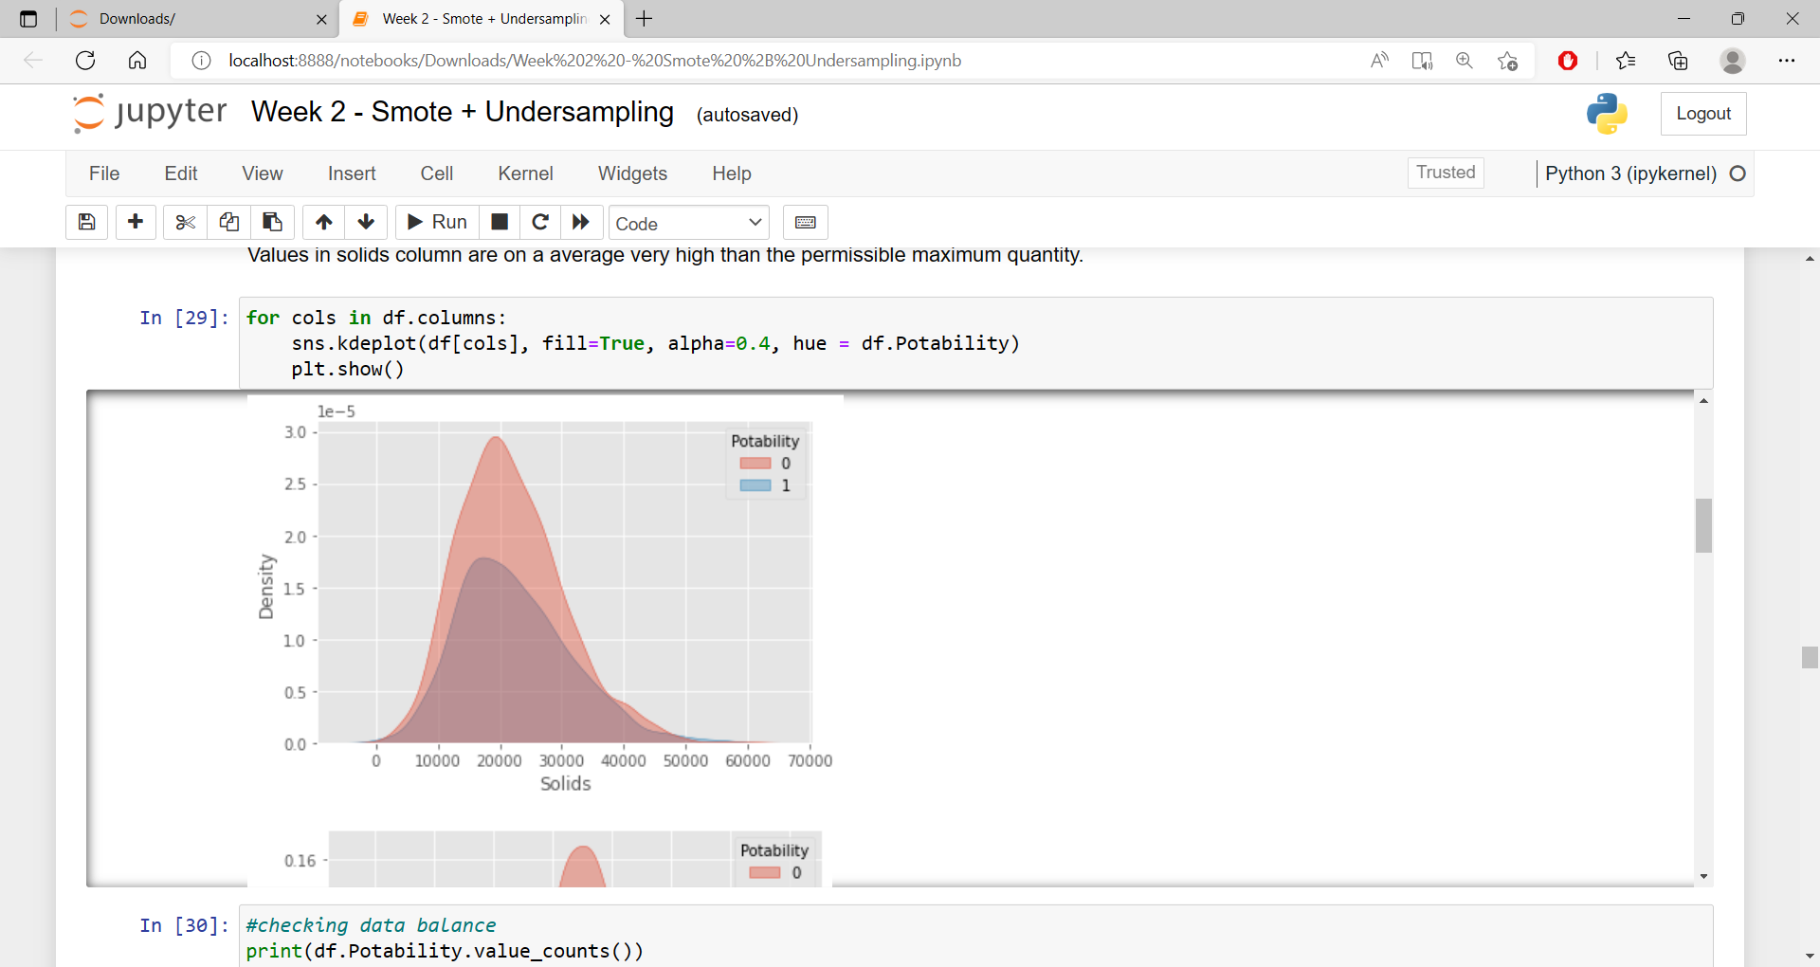
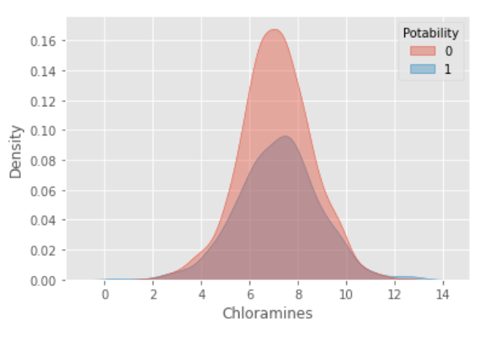
Multi-variate analysis
Ph column has high frequency of data between 6-8ph which is around its ideal value.
While chloramines have high frequency on the higher side of ideal value i.e. 4 parts per million.

Slide 9
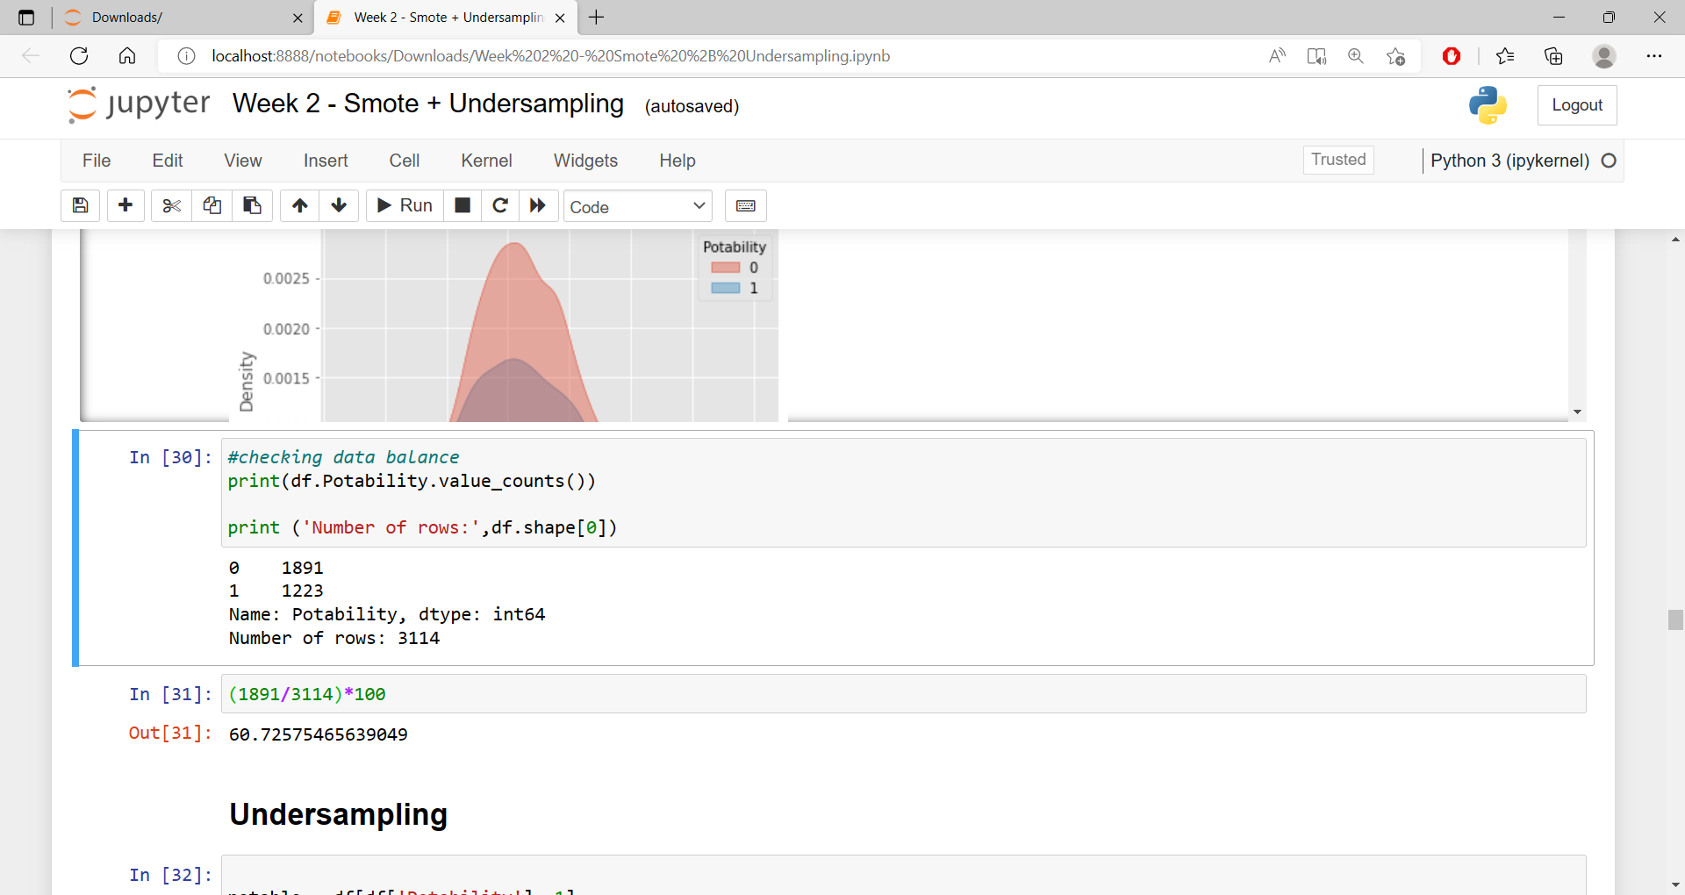
Checking for bias.

Slide 10
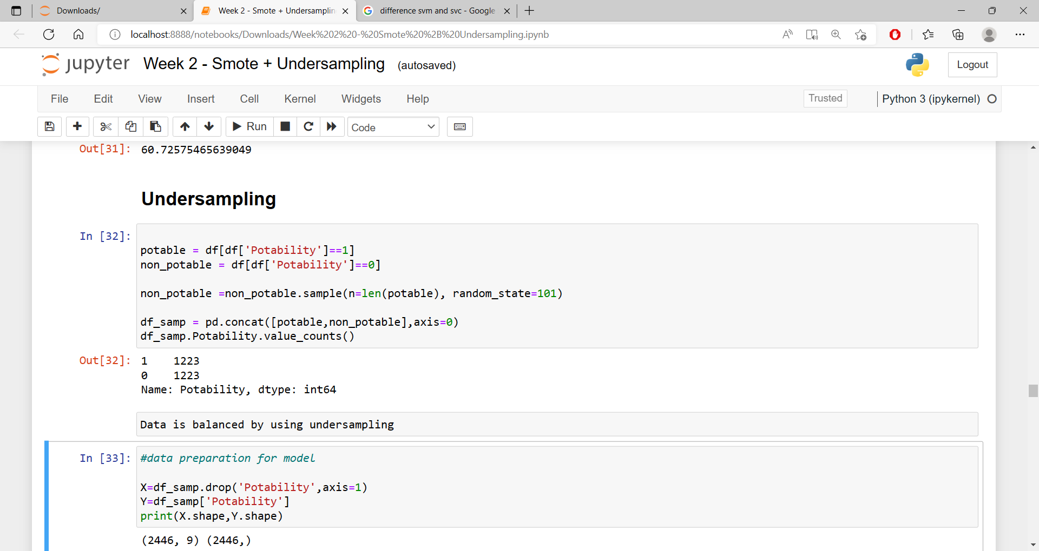
Handling the Bias

Slide 11
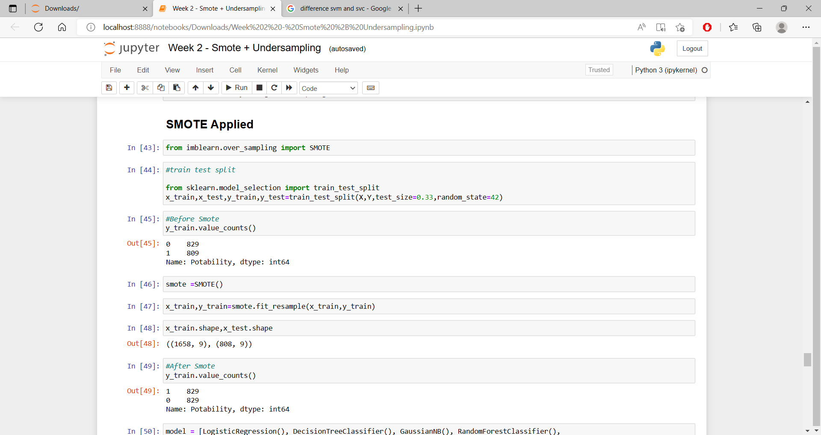
Handling the Bias

Slide 12
Models used
Decision Tree classifier
Xg-boost
Logistic regression
SVM
Random tree classifier
Gaussian NB
SVC
KNN

Slide 13
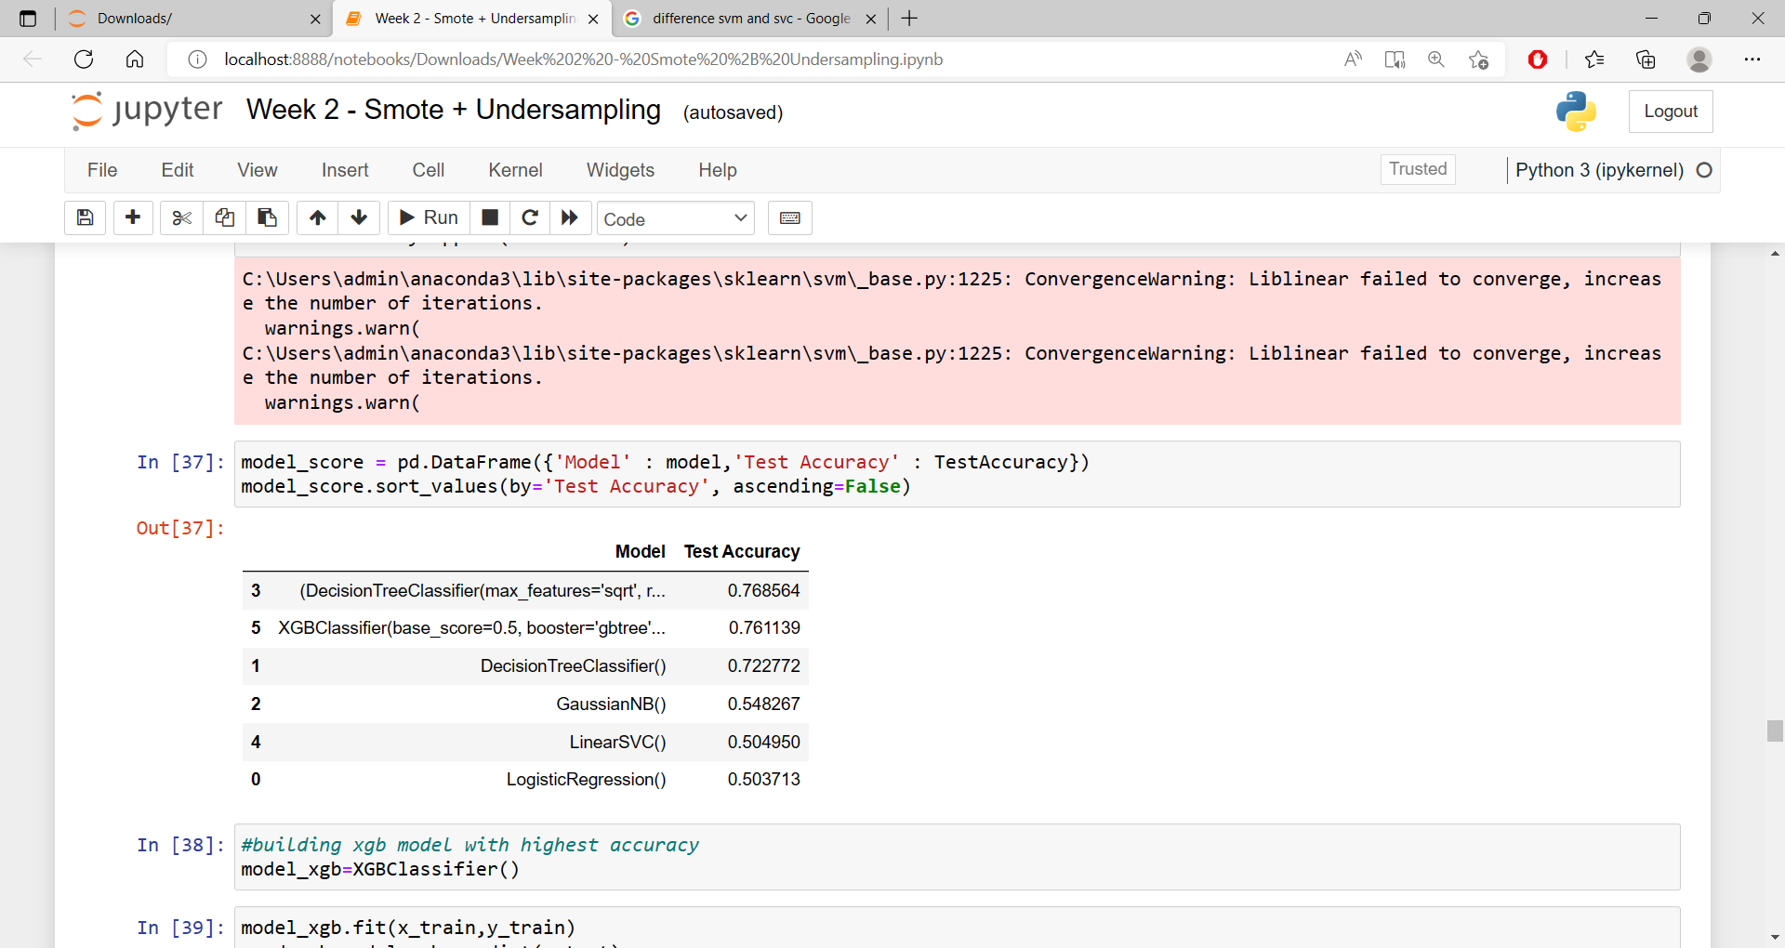
Model performance with under sampling

Slide 14
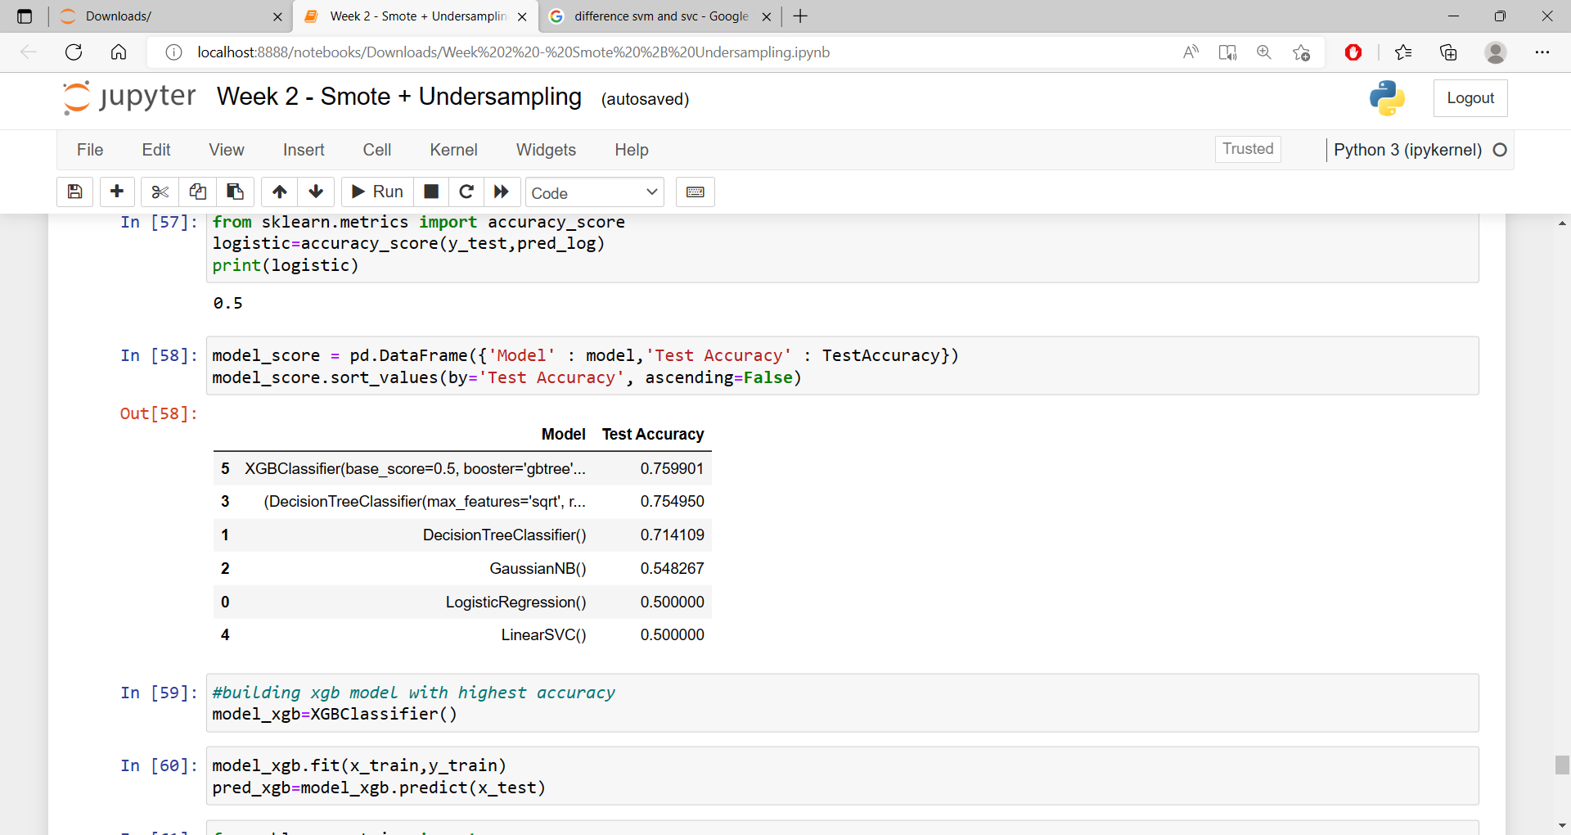
Model performance with over sampling (SMOTE)

Slide 15
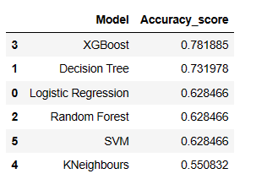
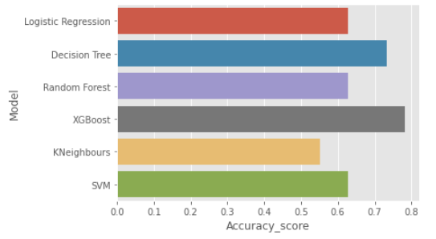
Model performance without bias handling

Slide 16
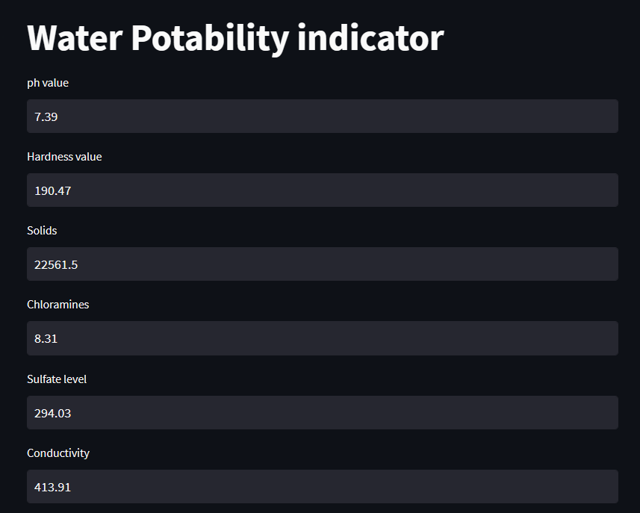
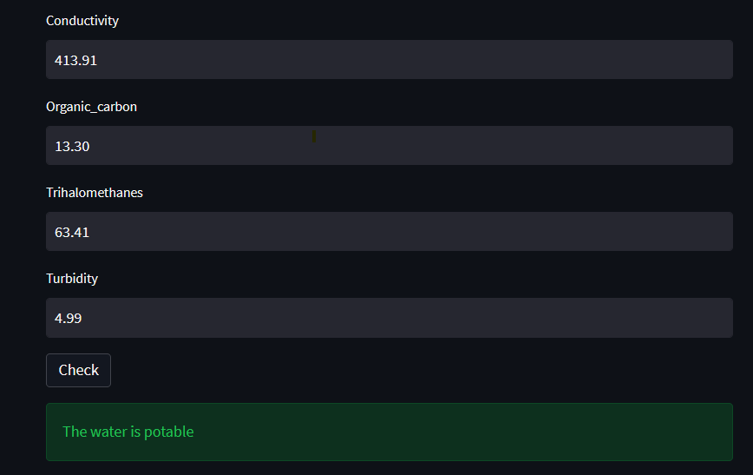
Deployment- Using Streamlit

Slide 17
Challenges Faced
Handling and imputing NULL Values
Challenge to select whether to implement population mean or to imputing null values with mean individually based on potability and non potability of water
Challenge to handle biased data by deciding to do undersampling, SMOTE or keeping the data as it is .
Deployment

Slide 18
THANK YOU

